Slide 1
Real life solution for waste management

Slide 2
What is Waste Management? Waste Management is the process of collecting, transporting, processing, recycling, and disposing of waste materials efficiently. Need for the Project Increasing garbage in urban areas Overflowing waste bins Delayed complaint resolution Environmental pollution

Slide 3
Problem Statement Existing System Manual garbage monitoring Delayed waste collection No proper complaint tracking Inefficient resource management Proposed System A digital platform for reporting, monitoring, and managing waste complaints efficiently.

Slide 4
Objectives Improve waste collection efficiency Reduce environmental pollution Enable online complaint registration Track complaint status Maintain cleanliness in public areas

Slide 5
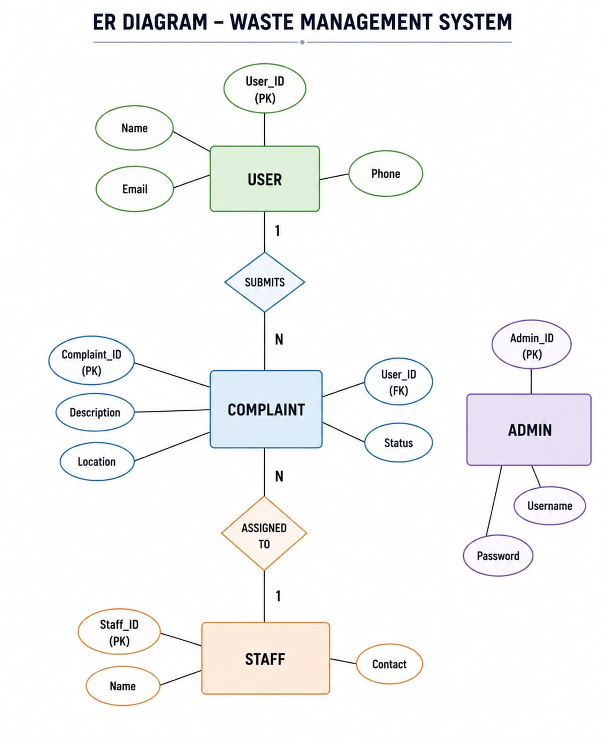
ER DIAGRAM

Slide 6
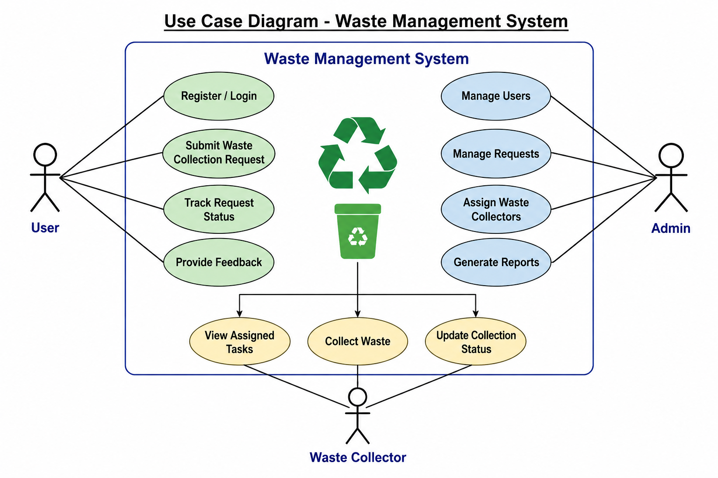
User case diagram

Slide 7
Thank You

